Slide 1

CAPSTONE PROJECT ML Insight Studio: An Intelligent Machine Learning Model Recommendation and Explainability Platform ITA0610 – Machine Learning
Supervised By:
Dr Madhusundar N
Student
Vasantha Nithi D Y(192424137)
Saravana Yogesh M(192412273)
Department of AIDS and ECE Saveetha School of Engineering
1

Slide 2


INTRODUCTION
Machine Learning is widely used for prediction and decision making.
Selecting the right preprocessing techniques is often challenging.
Poor preprocessing reduces model performance.
An intelligent recommendation system can simplify this process.
2

Slide 3
INTRODUCTION
Different datasets require different preprocessing methods.
Manual experimentation consumes time and effort.
Explainable recommendations improve user understanding.
The proposed system automates analysis and model comparison.
2

Slide 4
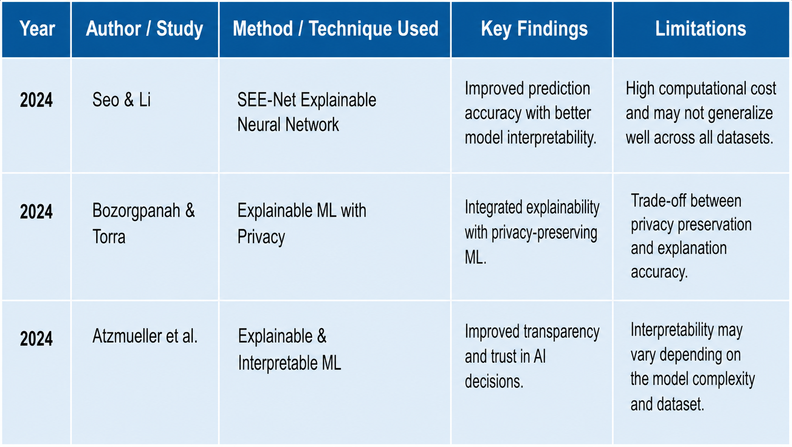
LITERATURE SURVEY

Slide 5
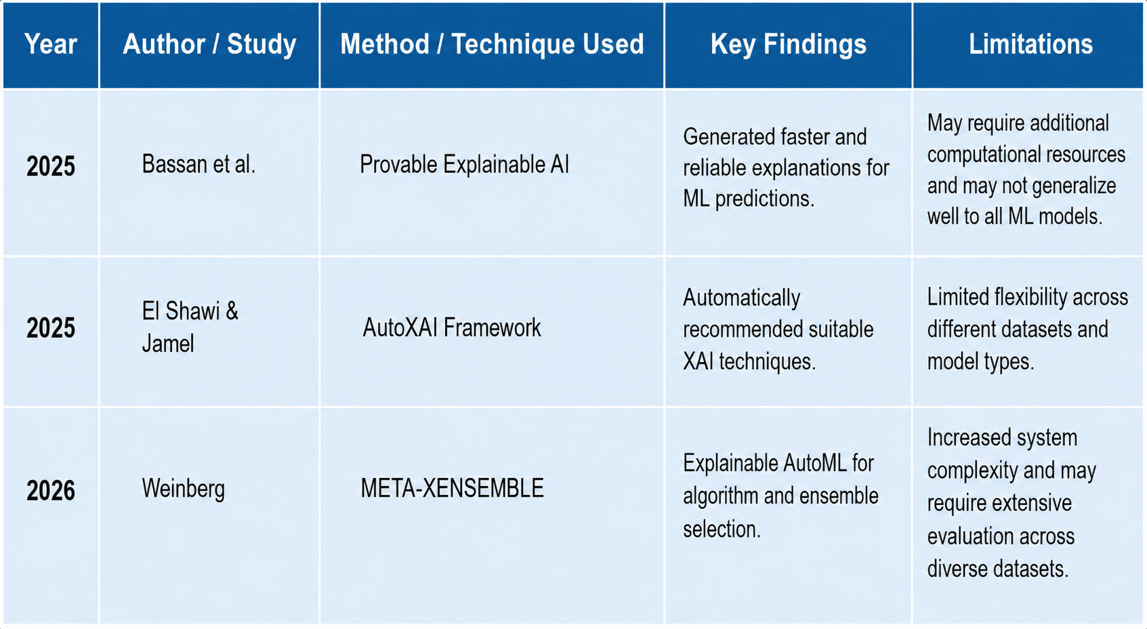
LITERATURE SURVEY

Slide 6
PROBLEM STATEMENT
Selecting preprocessing methods is difficult.
Choosing the best ML model requires expertise.
Existing tools provide limited explanations.
Users cannot easily compare multiple models.
A guided decision-support platform is needed.

Slide 7
RESEARCH GAP
To implement optimized, time-window–based SQL queries for real-time analysis of water level trends.
Limited preprocessing recommendations.
Lack of user-controlled preprocessing.
Poor explainability of model selection.
Few systems combine analysis and recommendation.
Need for an intelligent decision-support platform.

Slide 8
PROPOSED AIM
To develop an intelligent decision-support platform for machine learning model selection.
To simplify dataset analysis through automated preprocessing recommendations.
To improve model selection by comparing multiple machine learning algorithms.
To provide explainable insights that help users understand the recommended model.

Slide 9
PROPOSED OBJECTIVE
To analyse the uploaded dataset by detecting missing values, outliers, and duplicate records.
To recommend appropriate preprocessing techniques based on the dataset characteristics.
To train and evaluate multiple machine learning models for performance comparison.
To recommend the best model with explainable insights and generate a final report.

Slide 10
PROPOSED METHODOLOGY
The user uploads a structured dataset in CSV format to the system.
The dataset is analysed to identify missing values, outliers, duplicate records, and feature correlations.
Based on the analysis, the system recommends appropriate preprocessing techniques.
The user reviews and applies the recommended preprocessing methods.
5

Slide 11
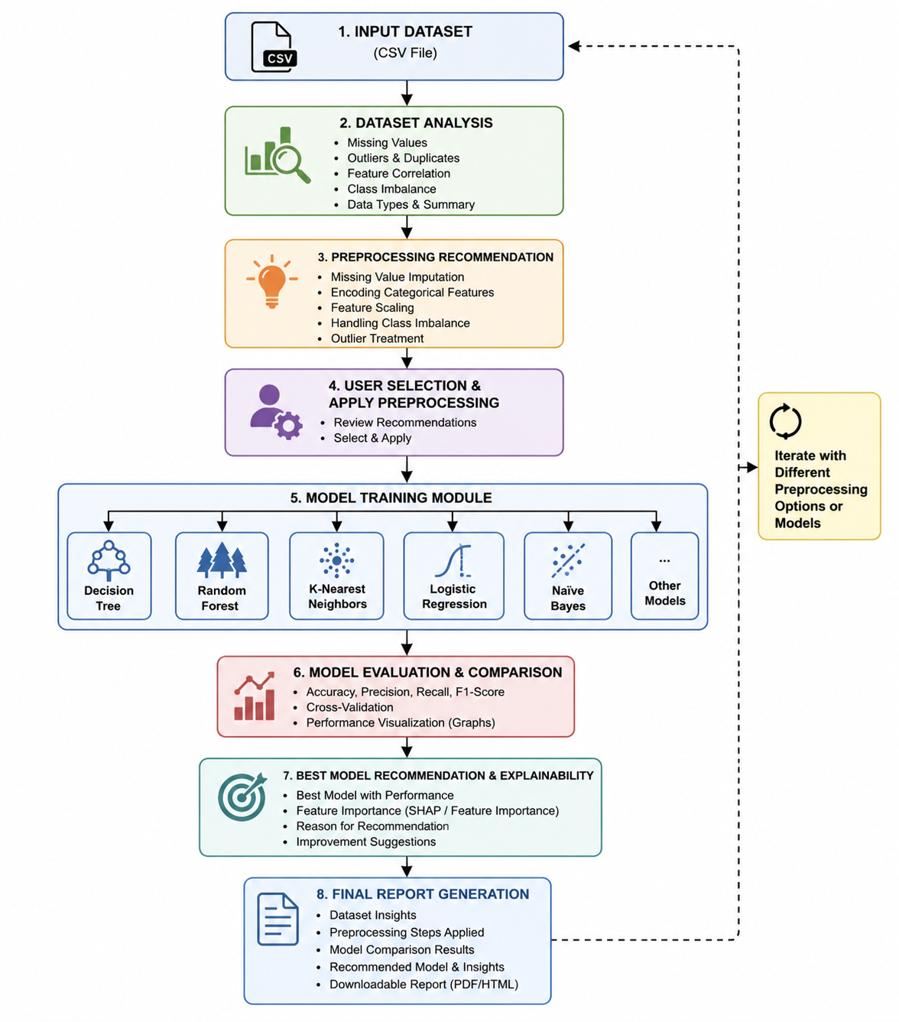
PROPOSED METHODOLOGY
5

Slide 12
Module 1: Intelligent ML Model Recommendation
Dataset Upload & Preprocessing – Upload CSV, clean missing/duplicate data, and prepare features.
Dataset Analysis – Identify data types, target variable, and determine classification or regression.
Model Training & Comparison – Train multiple ML algorithms and compare their performance.
Best Model Recommendation – Select and recommend the most suitable model based on performance.

Slide 13
Module 2: Explainable AI & Model Insights
Prediction Generation – Use the selected model to generate predictions.
Feature Importance Analysis – Identify the features that most influence predictions.
XAI Explanation – Apply SHAP/LIME to explain model decisions.
Visualization & Insights – Display explanations through graphs and provide easy-to-understand insights.

Slide 14
RESULT and DISCUSSION

Slide 15
IMPLEMENTATION VIDEO

Slide 16
CONCLUSION
ML Insight Studio simplifies machine learning by automatically recommending the most suitable model for a given dataset.
It reduces the need for users to have advanced knowledge of ML algorithms, preprocessing, and model selection.
The Explainable AI module helps users understand model predictions through feature importance and visual explanations.
Overall, the platform provides a user-friendly, intelligent, and transparent ML solution by combining automated model recommendation with explainability.

Slide 17
REFERENCES
Seo, J., & Li, X. (2024). SEE-Net: An Explainable Neural Network Framework. Scientific Reports, Nature. .
Bozorgpanah, A., & Torra, V. (2024). Explainable Machine Learning with Privacy Preservation. Springer Nature. .
Atzmueller, M., et al. (2024). Explainable and Interpretable Machine Learning. Data Mining and Knowledge Discovery, Springer.

Slide 18
REFERENCES
Scikit-learn Documentation – https://scikit-learn.org Pandas
Documentation – https://pandas.pydata.org NumPy
Documentation – https://numpy.org Kaggle Datasets –https://www.kaggle.com/datasets
IEEE Xplore Digital Library –https://ieeexplore.ieee.org

Slide 19
Thank You

